Slide 1
Weather Temperature Prediction, Analysis and Visualization

Slide 2
Overview
As each day progresses, we are witnessing an alarming increase in the severity of weather events. Among the most pressing global challenges we face is the rise in extreme temperatures. In this project, I aim to illustrate the changes in temperature and precipitation patterns from 2000 to 2019 in my hometown of Pabna. By providing this data, I hope to support authorities in making informed, data-driven decisions regarding climate-related initiatives and the timely implementation of governmental projects throughout the year.
Data Preprocessing
Exploratory Data Analysis
Precipitation Trend Analysis
Model Training & Evaluation
Conclusion and Result

Slide 3
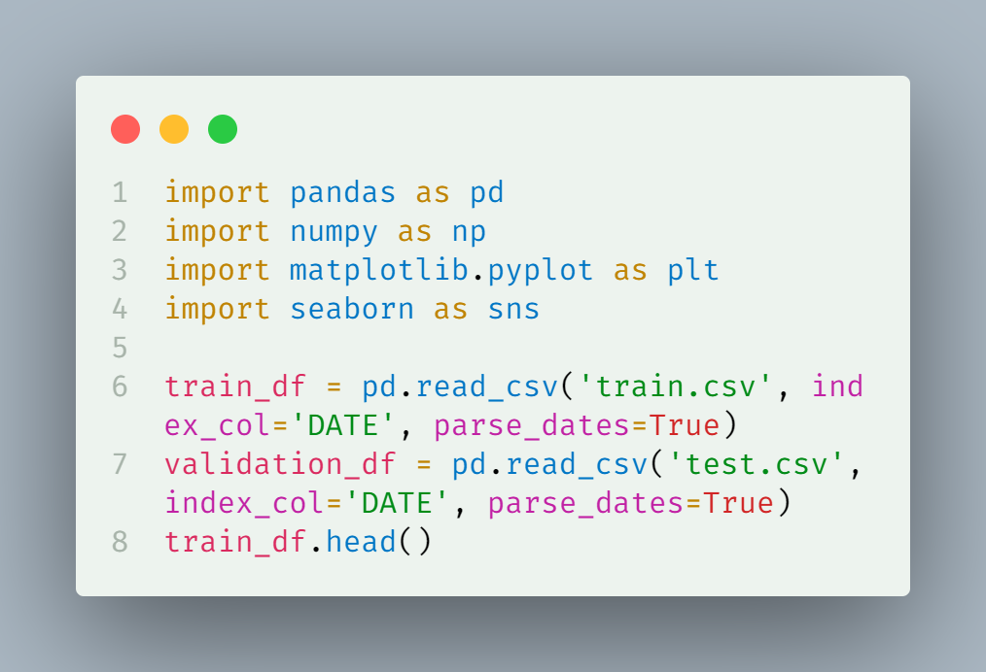
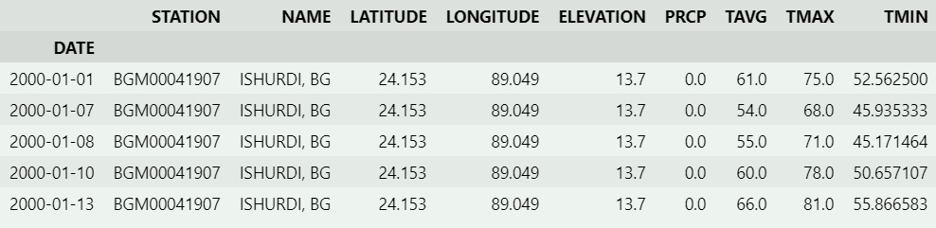
Initial Data import & Exploration

Slide 4
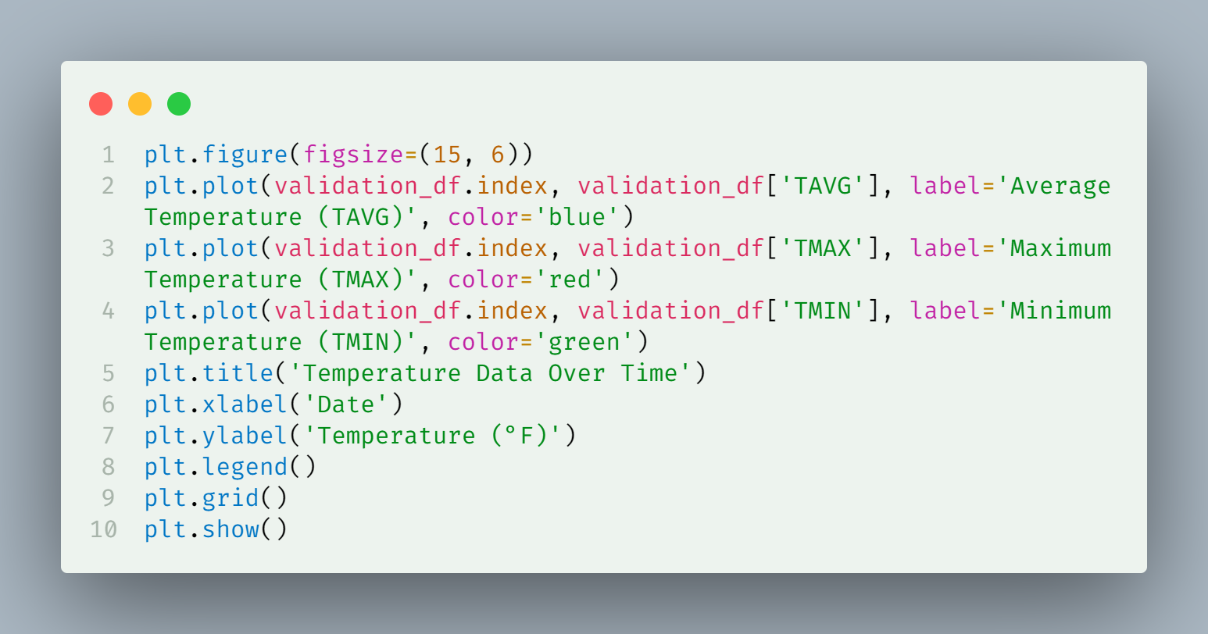
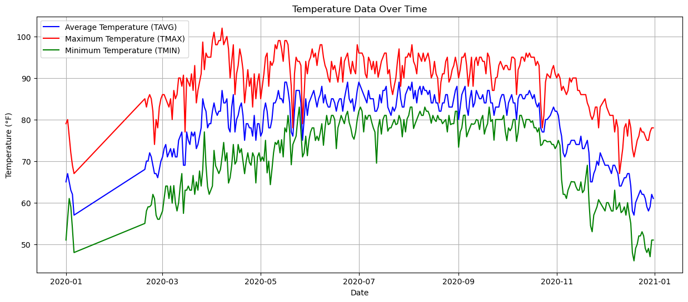
Temperature Data Visualization
Temperature is in Fahrenheit scale which needs to be converted to Celsius scale

Slide 5
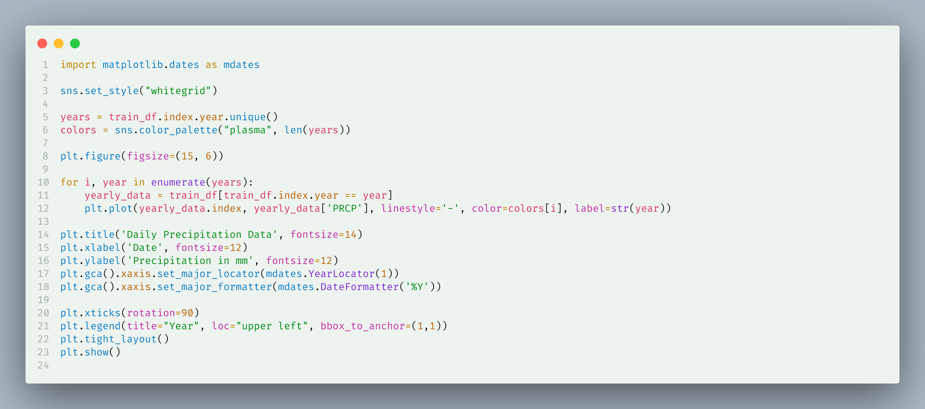
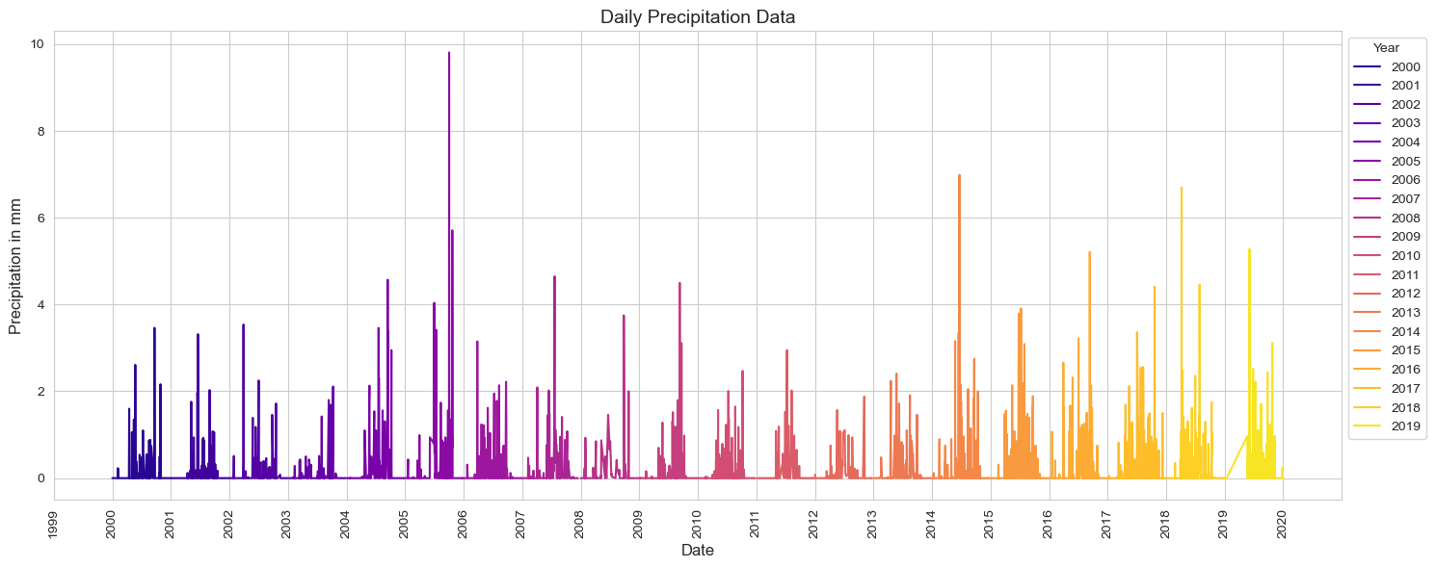
Precipitation Analysis

Slide 6
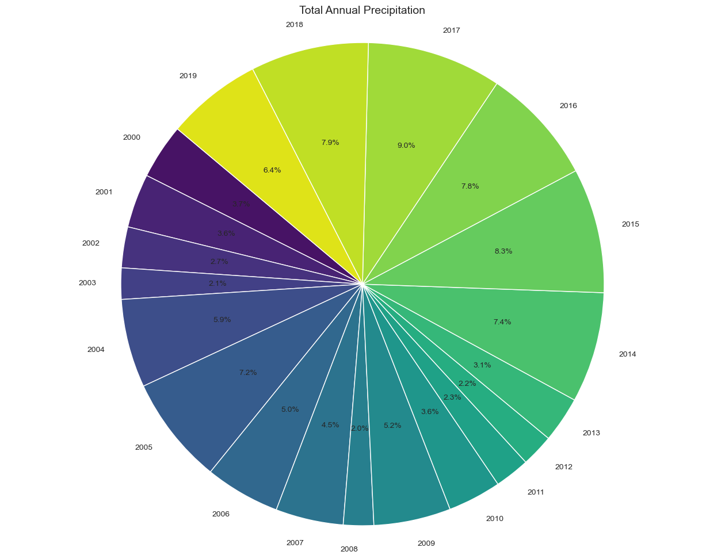
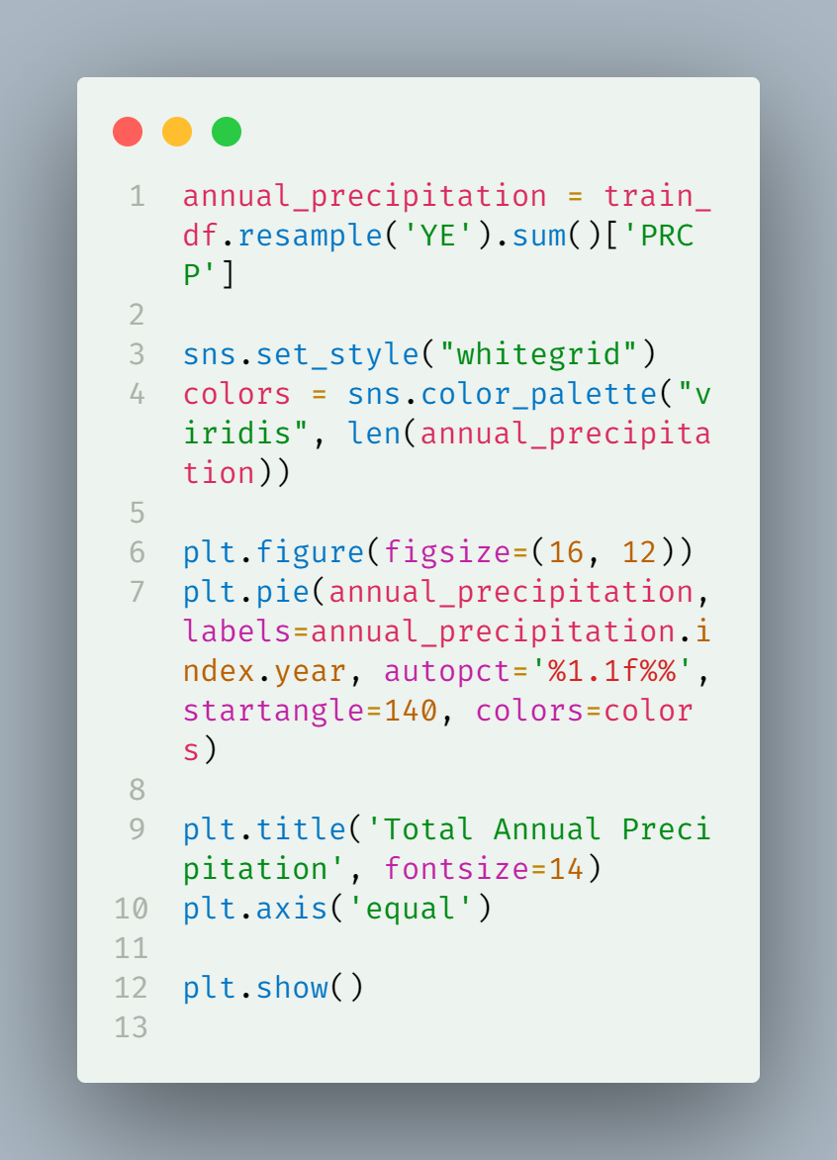
Total Annual Precipitation by Year

Slide 7
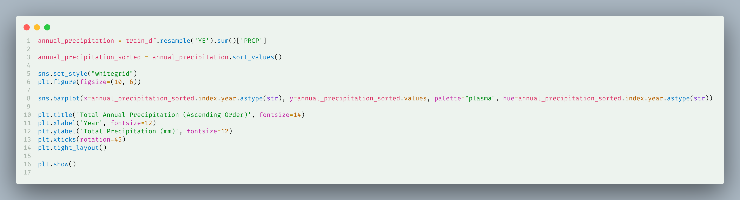
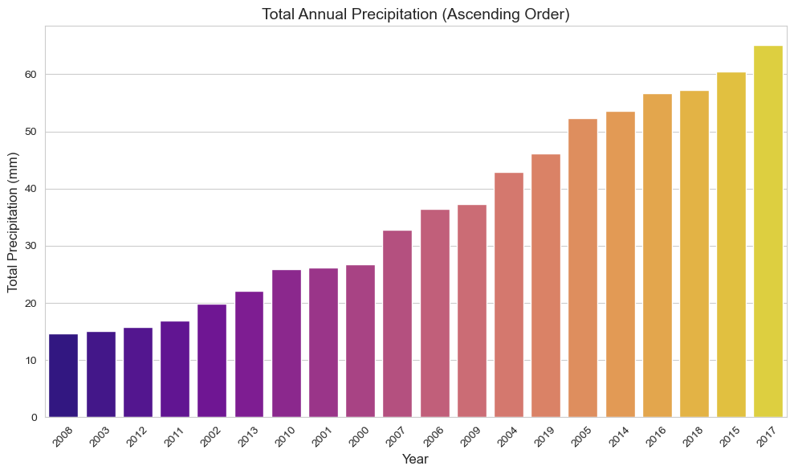
Total Annual Precipitation by Year
(Ascending)

Slide 8
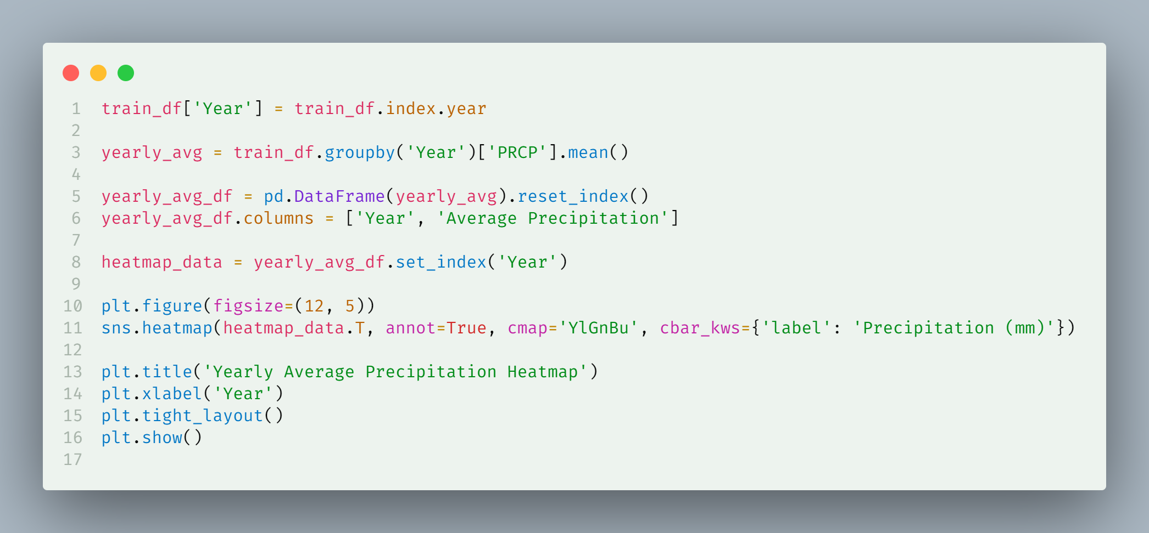
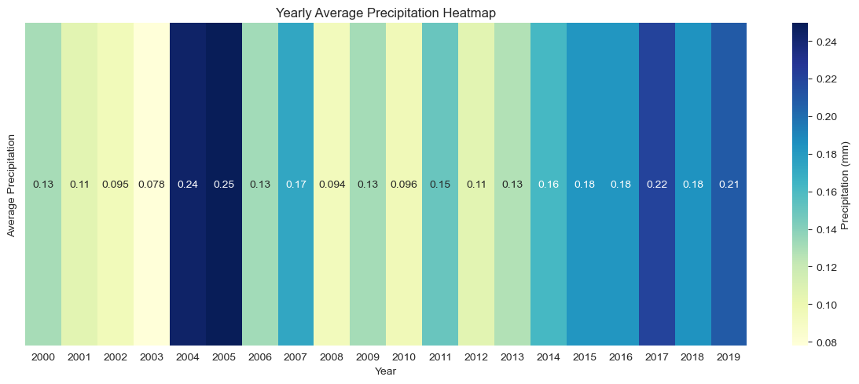
Correlation Heatmap for Trend Detection in Precipitation

Slide 9
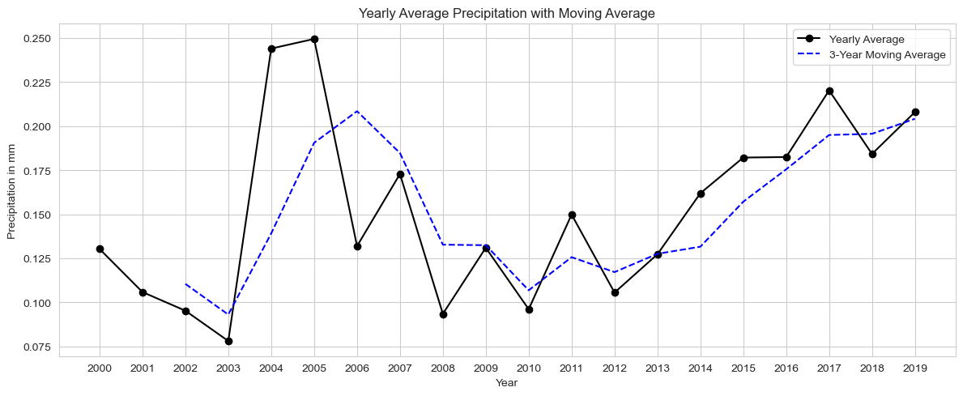
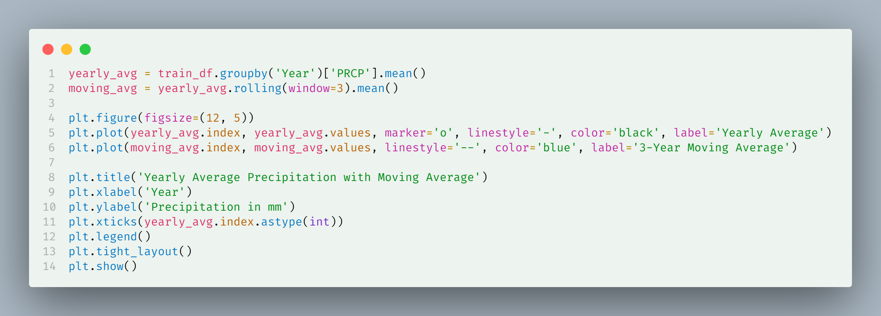
Moving Average Trend Detection for Precipitation

Slide 10
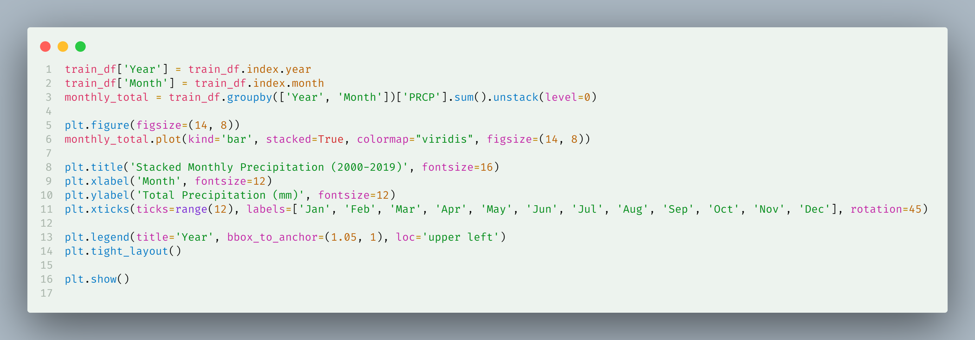
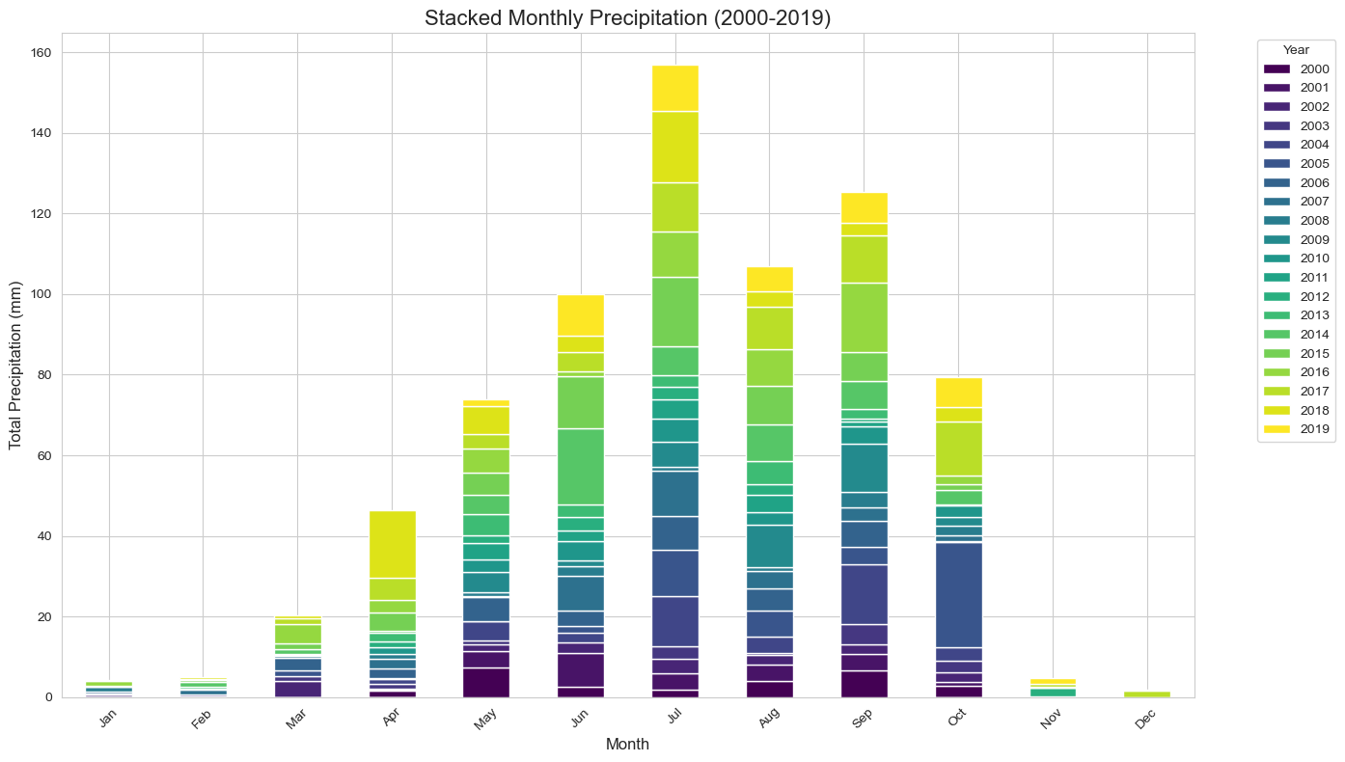
Monthly Precipitation for weather Extremeness measurement

Slide 11
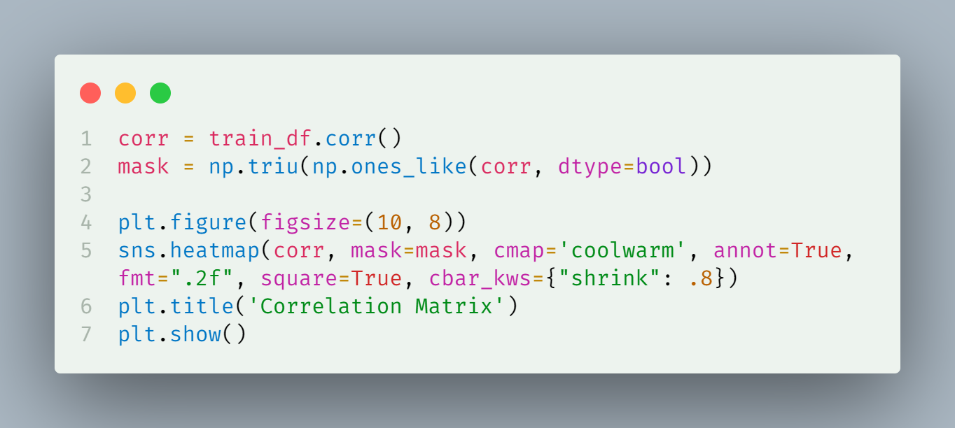
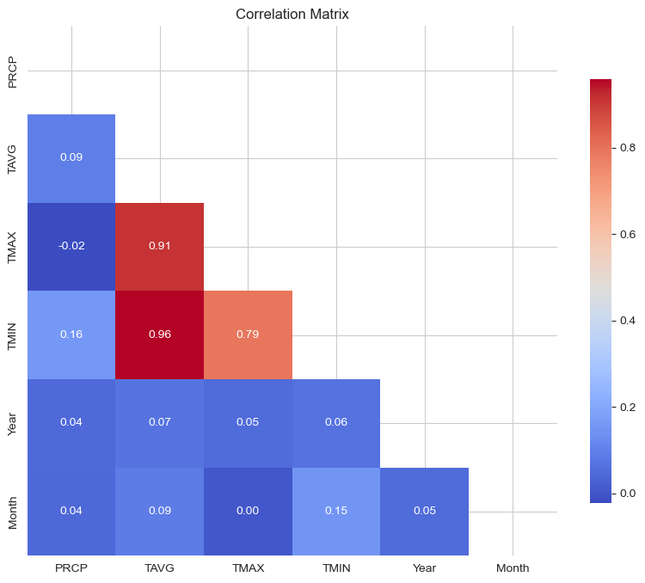
Correlation Analysis

Slide 12
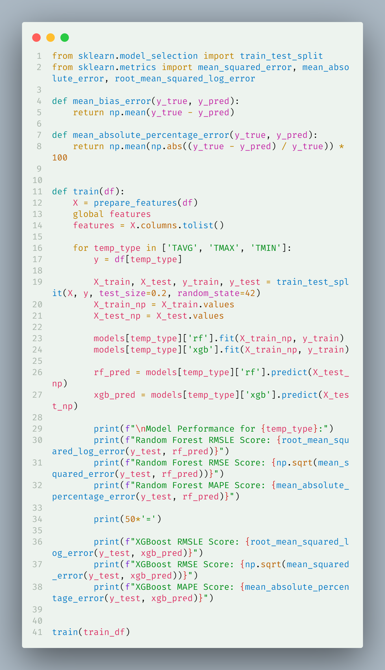
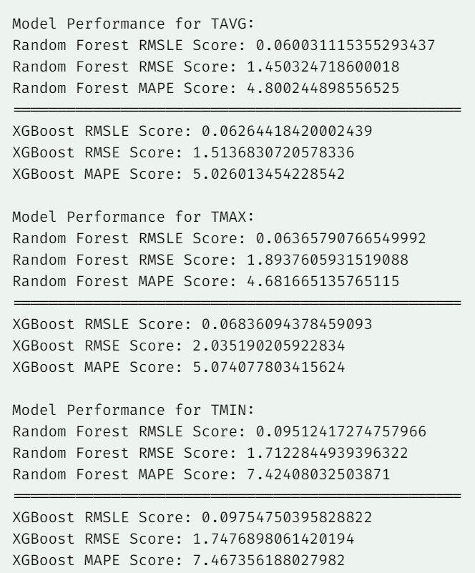
Model Training and Performance Measurement

Slide 13
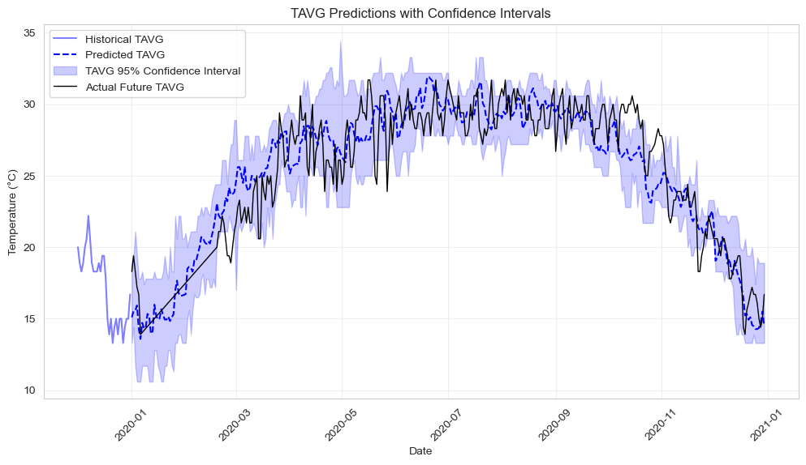
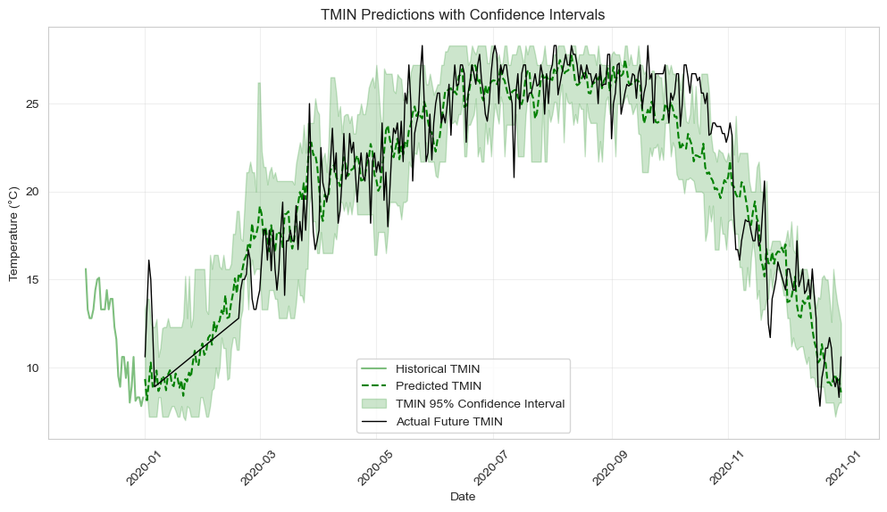
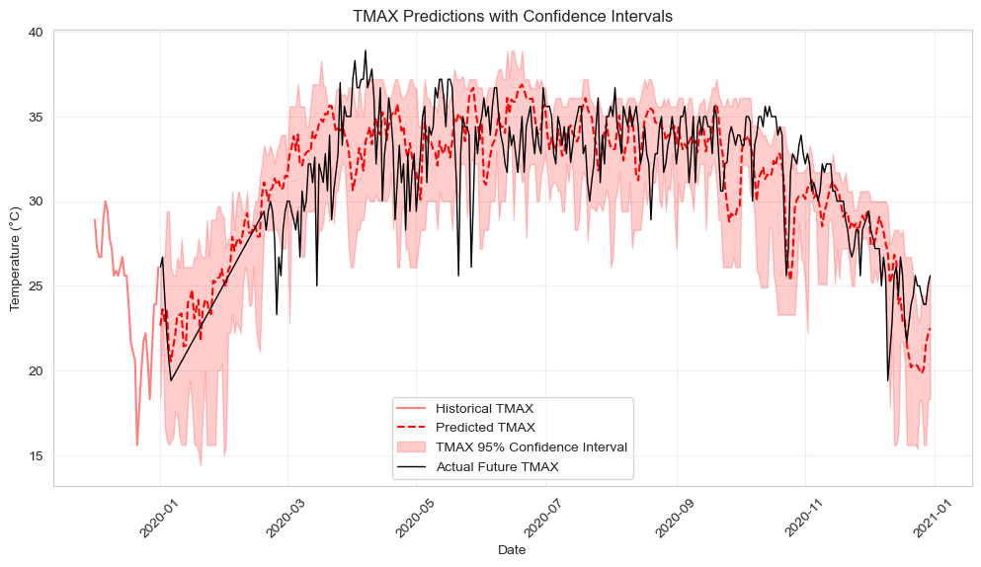
Performance measurement on test data
(with Confidence Interval)

Slide 14
Model Performance
Metric | TAVG | TMIN | TMAX
RMSE | 3.89 | 4.61 | 3.61
MAE | 2.99 | 3.65 | 2.82
RMSLE | 0.17 | 0.27 | 0.12
MAPE | 13.14 | 21.23 | 9.33

Slide 15
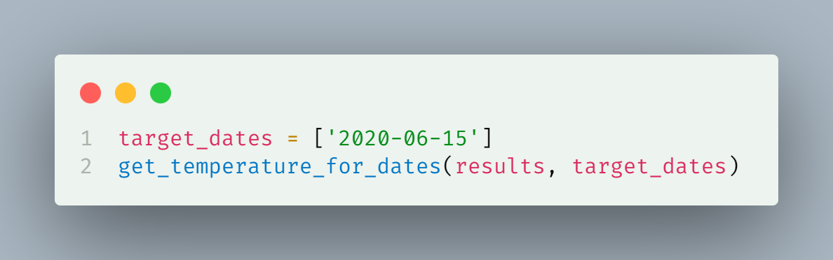
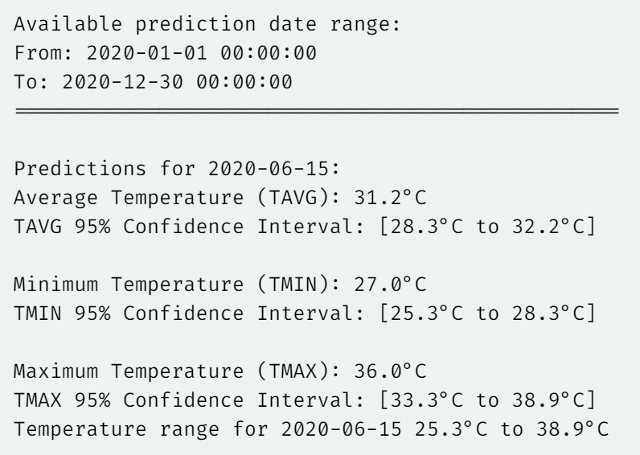
Future Temperature Prediction with CI
The temperature is predicted for a specific date in the future using a completely separate holdout set. The actual values for that day was:
Average Temp. : 29.4°C
Minimum Temp. : 26.1°C Maximum Temp. : 33.3°C
Which suggests that the model is performing very well on future data.

Slide 16
Conclusions and Results
The models show strong predictive performance with:
Low RMSE values indicating accurate predictions
Reasonable confidence intervals capturing temperature variations
Good handling of seasonal patterns
Key Findings:
Temperature predictions maintain realistic ranges between min and max values
Models capture seasonal patterns effectively
Ensemble approach (RF + XGBoost) provides robust predictions
‘TMIN’ gave high MAPE which is the cause of data imputation and having too much missing data
Visualization Results:
Clear seasonal patterns in temperature data
Strong correlation between different temperature metrics
Effective confidence interval estimation for predictions
Model Performance:
XGBoost generally outperforms Random Forest
Combined ensemble approach provides more stable predictions
Models handle both short-term and long-term predictions effectively

Slide 17
Md. Rafiquzzaman Rafi
+8801846385072
rafiquzzamanrafi100@gmail.com
Thank you

